Slide 1
Ethos, Pathos, and Logos
The Art of Rhetoric:

Slide 2
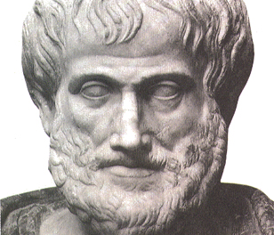
Rhetoric:
the practice of communicating argument effectively
Aristotle created the concept of rhetoric while he was working with teacher and mentor, Plato.
He defined ethos, pathos, and logos as the prime components of rhetoric.
Ethos is Greek for “character”.
Pathos is Greek for “experience”.
Logos is Greek for “word”.

Slide 3
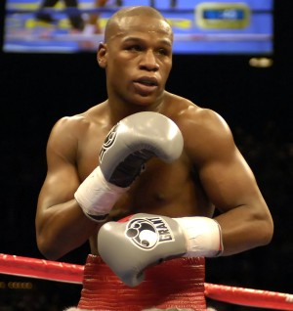
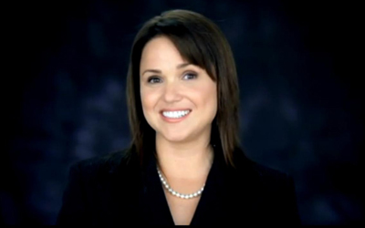
Ethos:
establishes speaker credibility, trustworthiness, and believability.
While viewing the links below, determine whether the speaker is a credible source

Slide 4
Ethos
How can I use ethos in my argumentative essay?
Establish the right tone
Ex.) the difference between “be quiet” and “shut up”
Particularly important in how you approach your counterargument
Know your audience
Be aware of what is common knowledge about your topic and what is not
Don’t provide unnecessary information

Slide 5
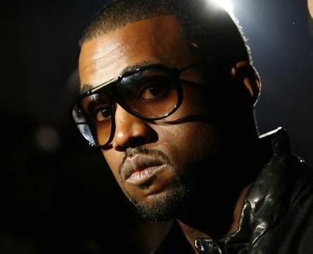
Pathos:
creates an emotional response and establishes a connection between speaker and audience.
While viewing the links below, determine whether the speaker creates a connection with his or her audience.

Slide 6
Pathos
How can I use pathos in my argumentative essay?
Use humor
An argumentative essay is a dialog between author and audience. Humor makes readers more apt to listen to what you have to say
Tell a personal anecdote
Stories about actual experiences make you seem more authentic
Helpful to use in introductory paragraphs; shows audience topic affects real people
Be relatable
Present yourself as a person instead of a font. Your audience should think of you as a real person, not just a paper

Slide 7
Logos:
presents logic, reasoning, and facts.
While viewing the links below, determine whether the facts the speaker presents are relevant and valid.

Slide 8
Logos
How can I use logos in my argumentative essay?
Use statistics
Statistics are the result of practiced, monitored, and measured study
Know your topic/Use legitimate sources
If you’re writing about sports, use prominent members in the field as sources. And I don’t necessarily mean the playing field.
Define terms that may be unclear
You’re the expert, so write like one.

Slide 9
Theory into Practice
Determining the validity of an argument
As you watch Frank, Dennis, Dee, Mac, and Charlie present an argument to the court, take note of their use (or non-use) of ethos, pathos, and logos to determine whether they present a valid argument.

Slide 10
While writing your paper…
Ask yourself:
Do I present myself as a credible source? (Ethos)
Do I sound authentic, genuine, and real? (Pathos)
Is my information accurate? (Logos)

